Slide 1
GOMIDA
Delivering solutions to alleviate pain, bring back dignity to people and make environmentally sustainable products.
Contact -
Email- sunil.singh@gomidamed.com
Phno.- (+91) 9560925518
310 Avenue Eugène Avinée Parc Eurasanté, 59120 Loos, France

Slide 2
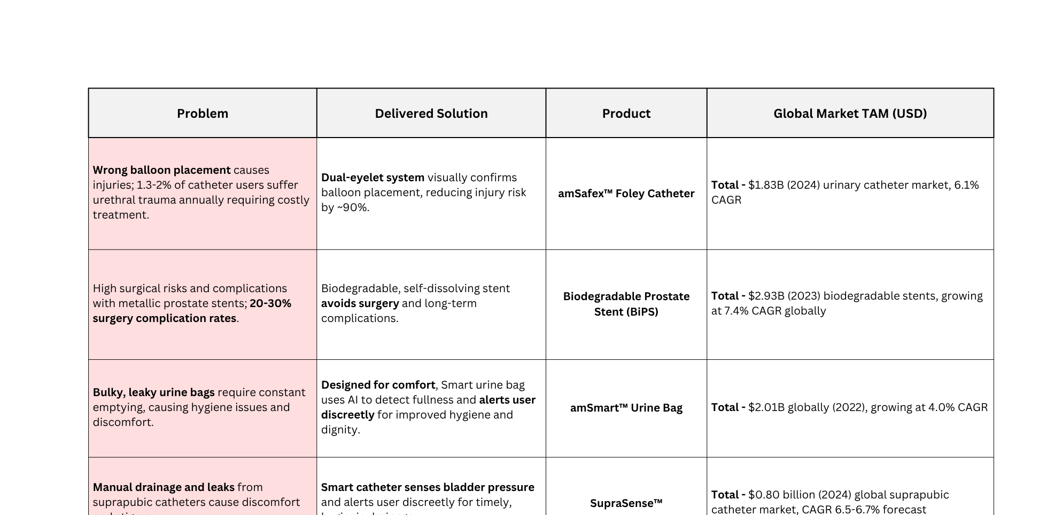
Problem & Solution
Total TAM of our product line -
$7.57B
GOMIDA

Slide 3
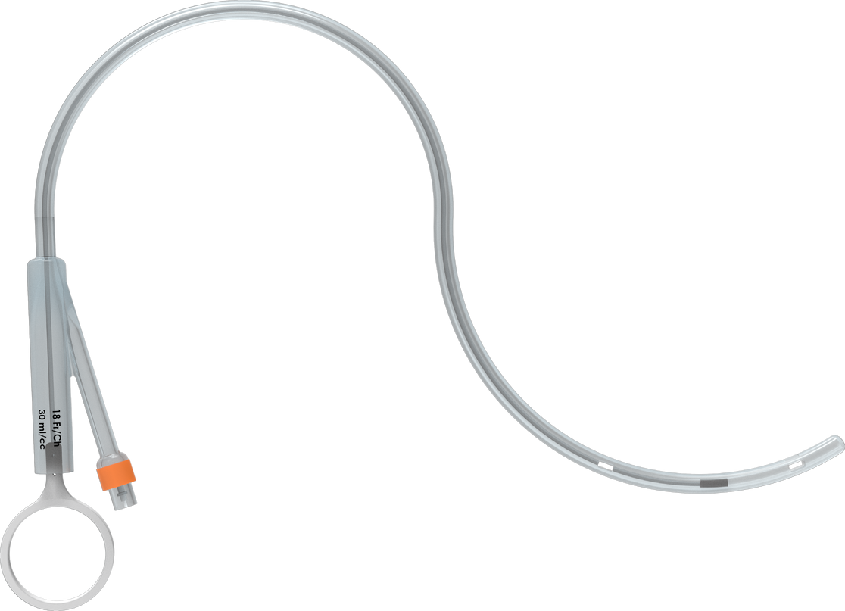

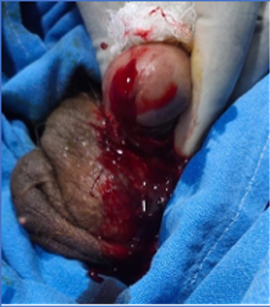
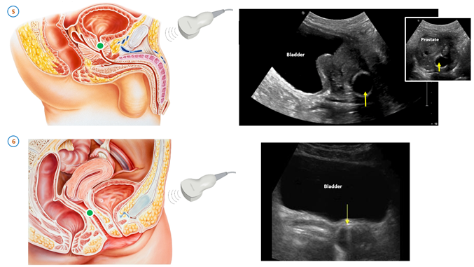

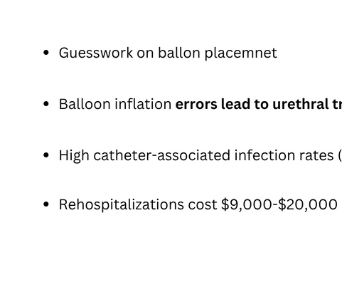


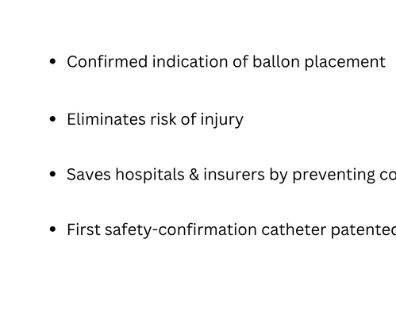
amSafex™ - Urology indwelling Catheter
thread connected between obturator and pulling ring
drainage port
drainage eye 2
drainage eye 1
obturator
pulling ring to pull out the obturator
balloon
*Patient Applied
Link to research paper
GOMIDA

Slide 4
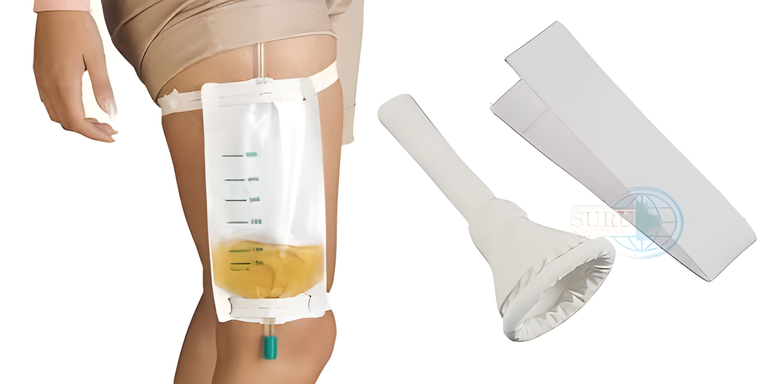
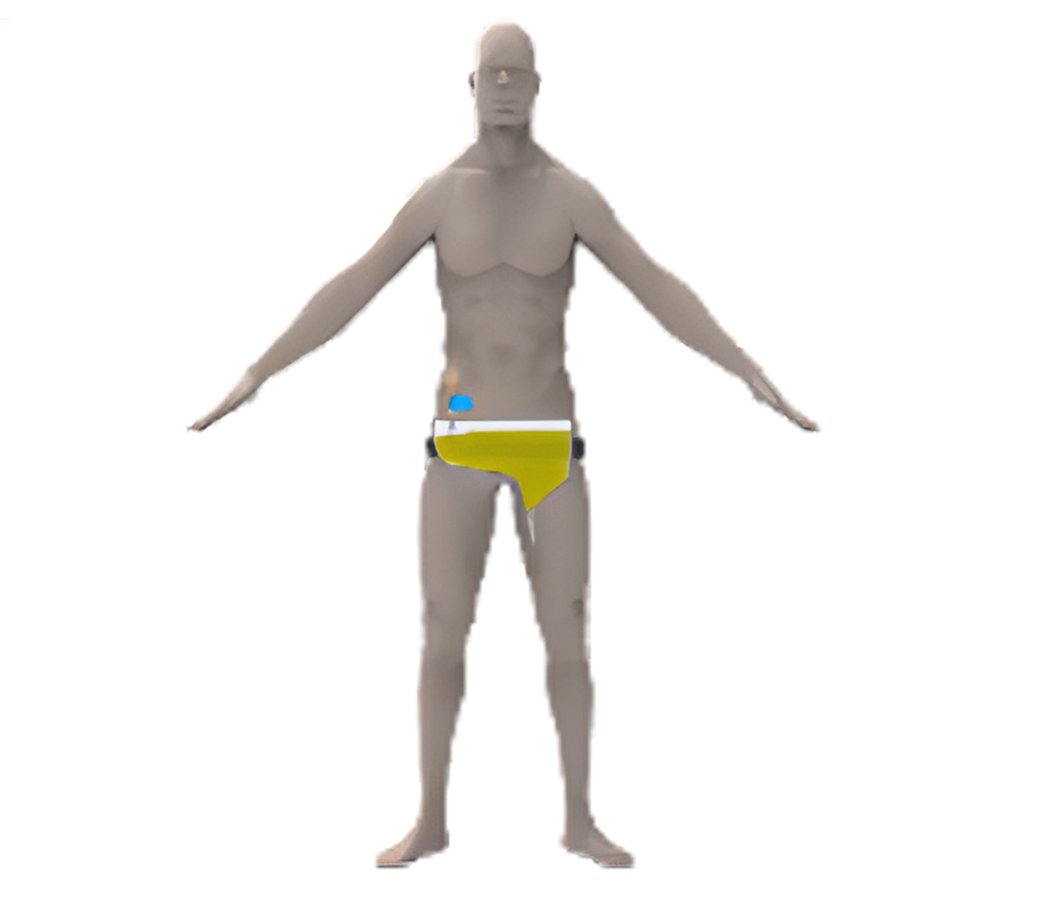
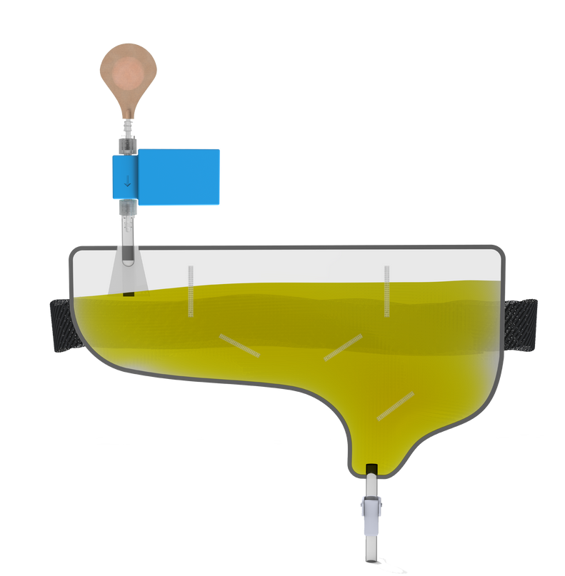
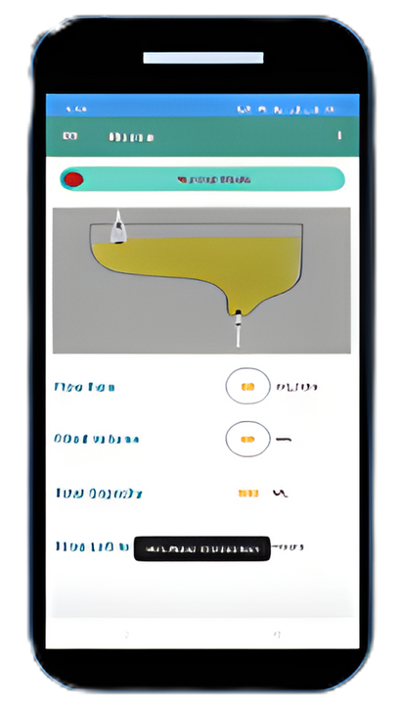

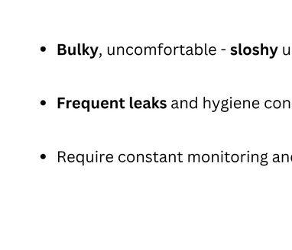
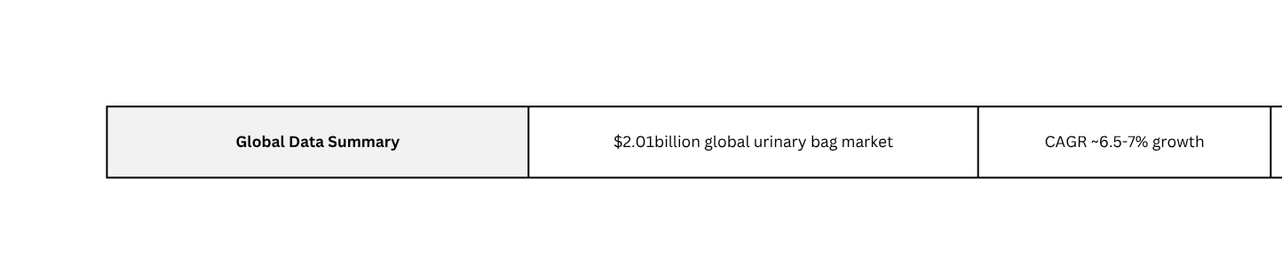

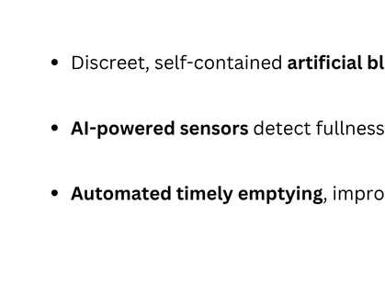

amSmart™ Urine Bag
*Patient Applied
Link for Research link
GOMIDA

Slide 5
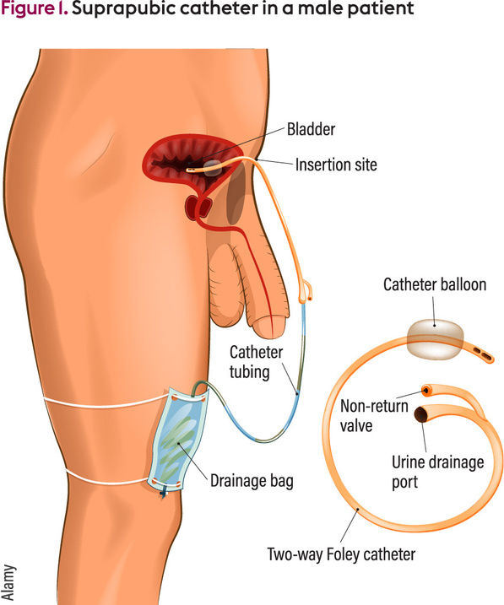
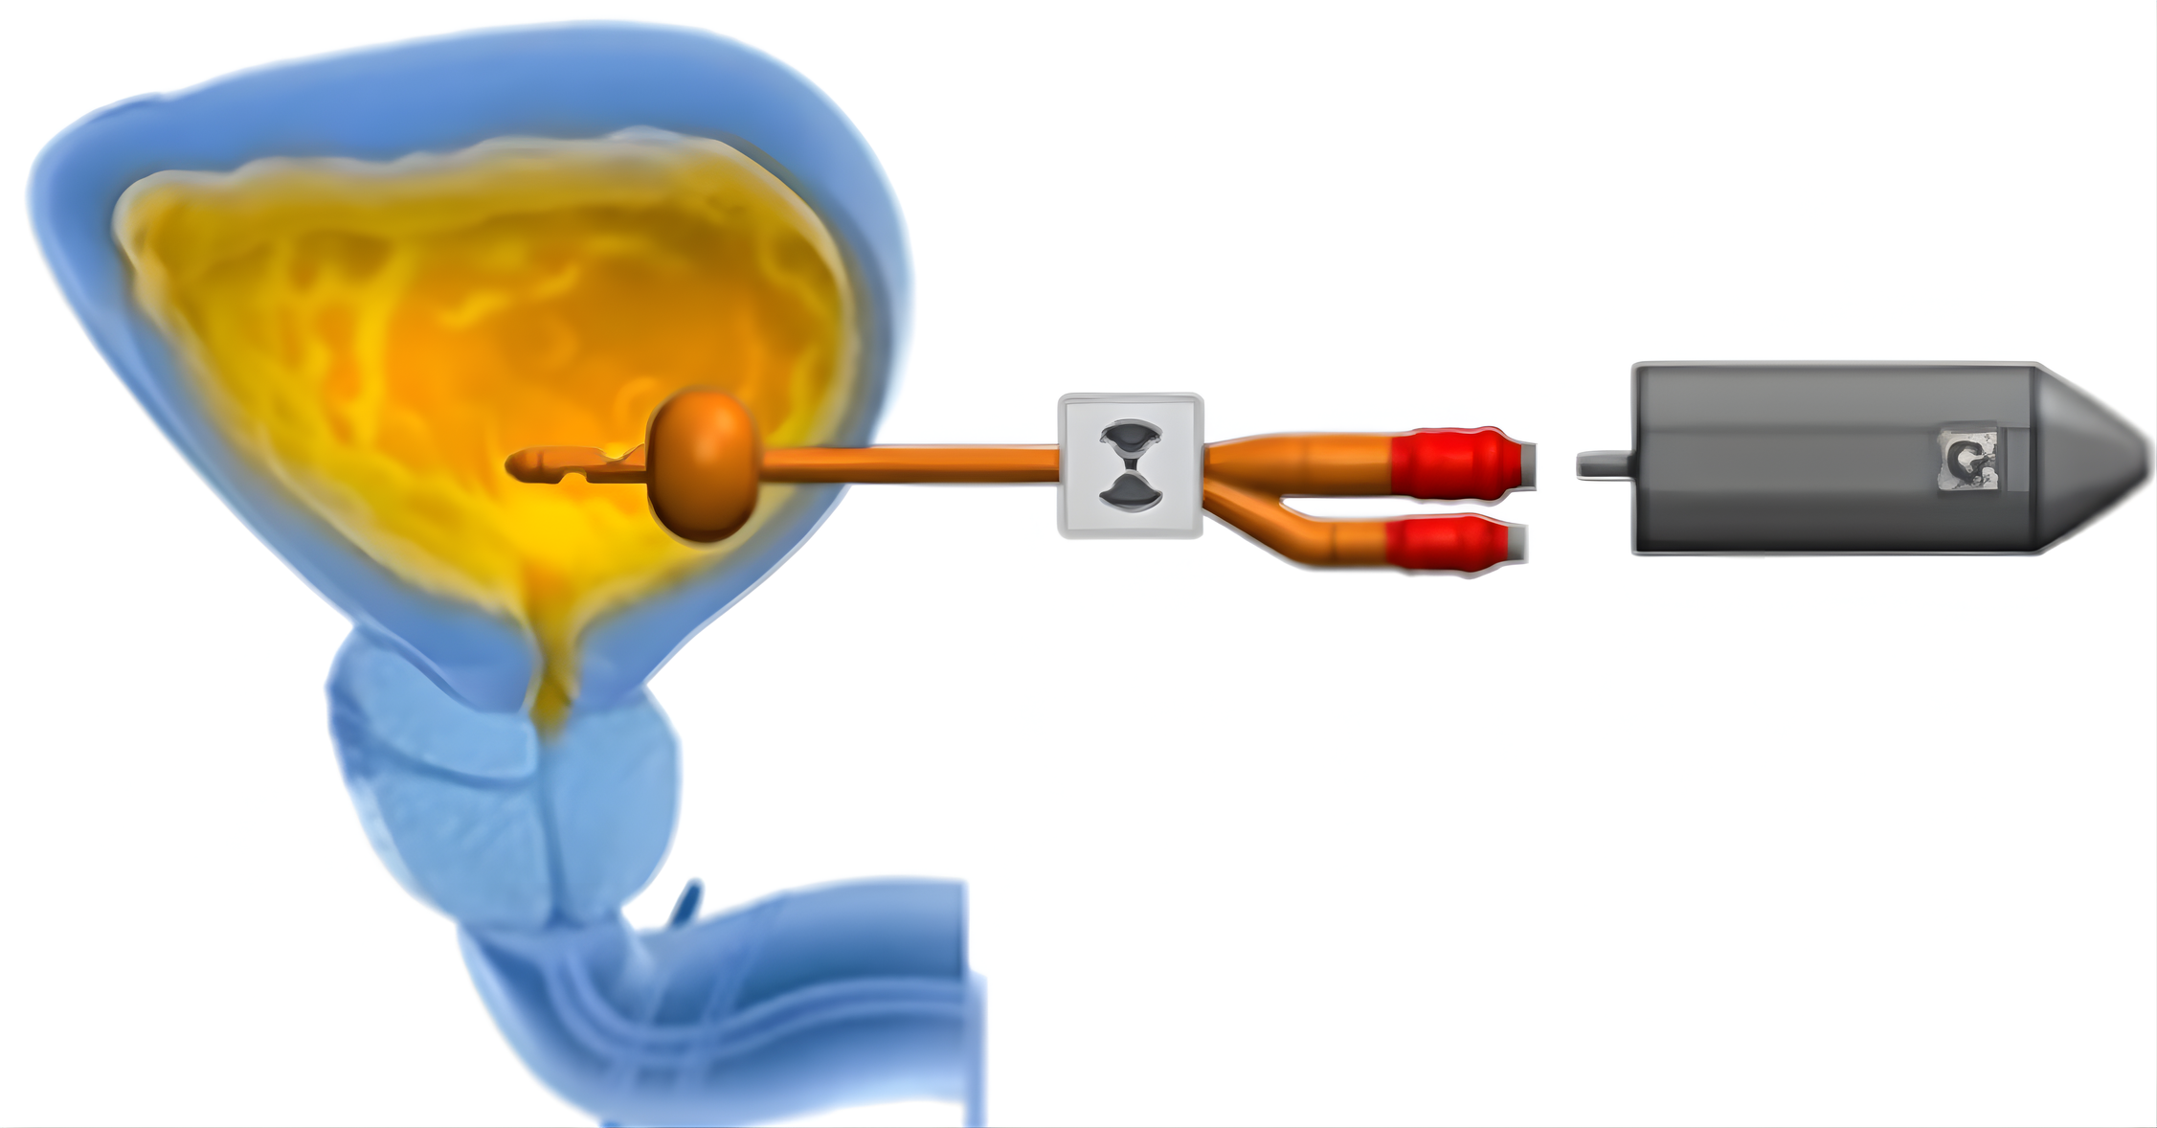

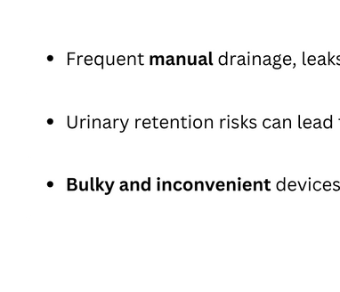


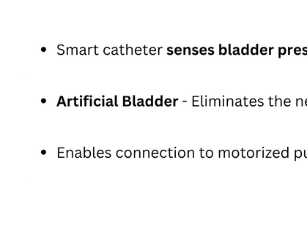

SupraSense™
Urine bladder with sensory dysfunction
Bladder Pressure Sensor
Reusable Urine drainage pump
*Patient Application under process
Link to research paper
GOMIDA

Slide 6
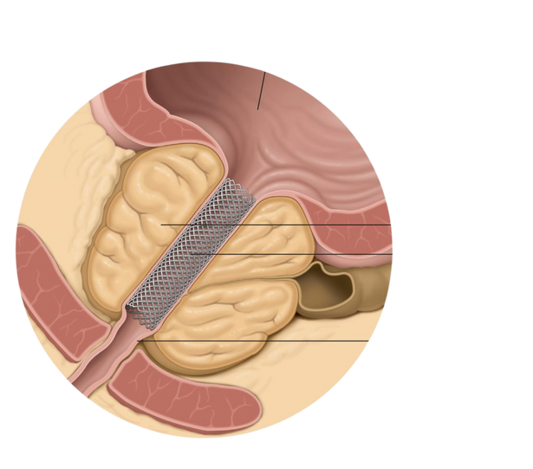
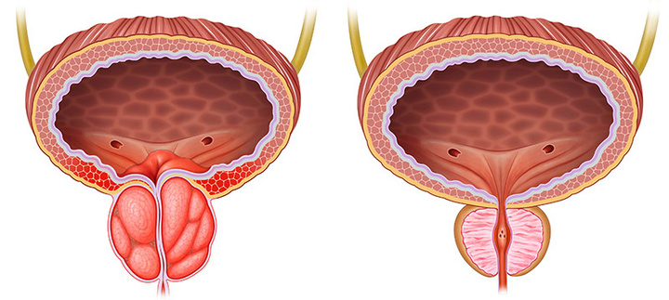
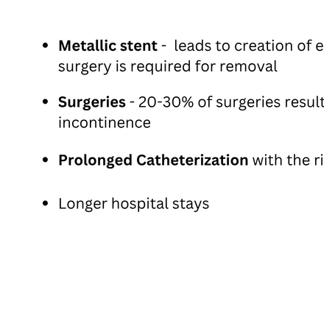
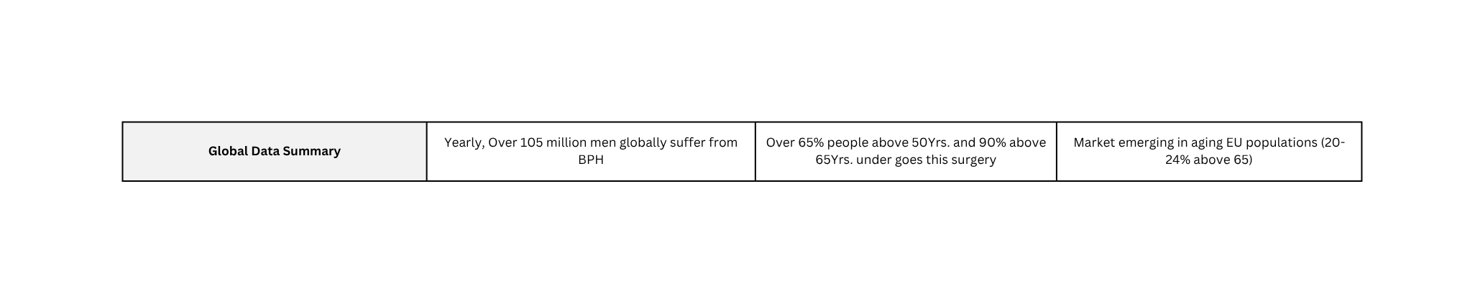

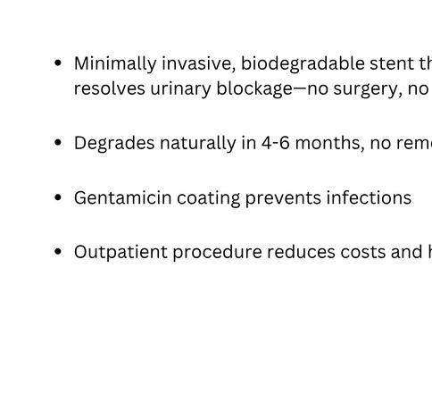

Biodegradable Prostate Stent
Bladder
Normal Prostate
Urine Bladder
Enlarged Prostate
Enlarged Prostate
Stent
Urethra
Normal Prostate
Normal urethra
Enlarged Prostate
Obstructed urethra
*Patient Application under process
Link to research paper
GOMIDA

Slide 7
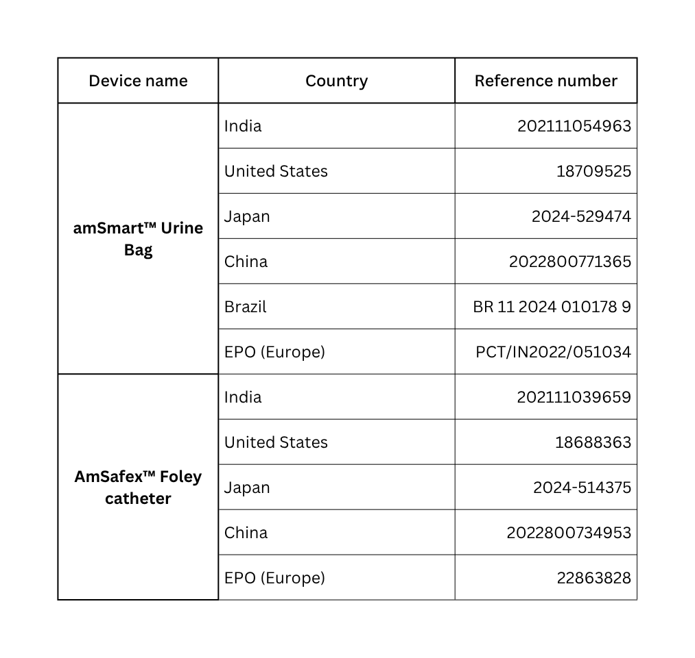
Patient profile
Patient application under process
  Biodegradable prostate stent
  SupraSense™
GOMIDA

Slide 8
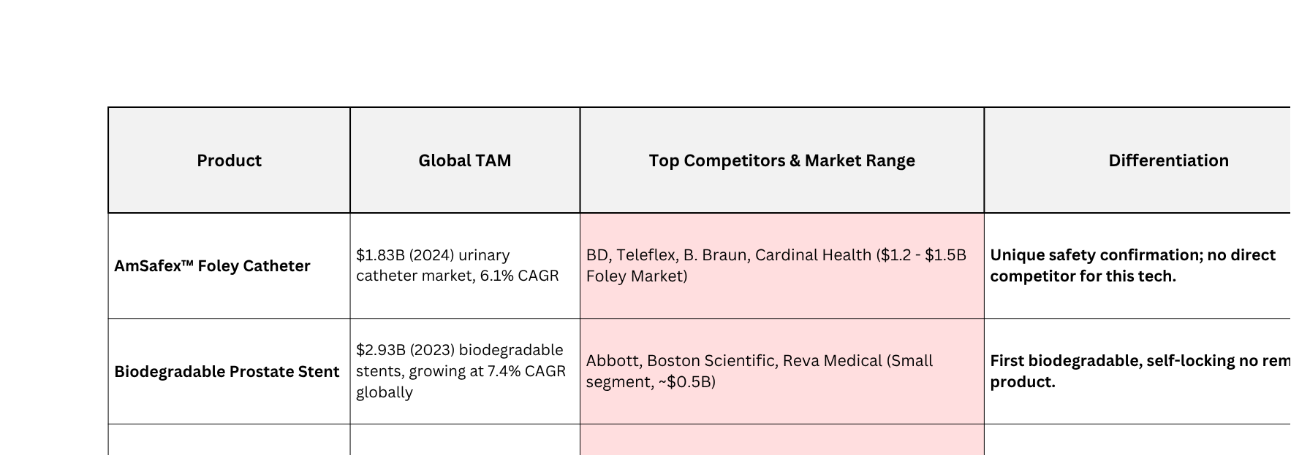
Competitive Landscape
GOMIDA

Slide 9
Roadmap Review
Acquisition of FDA approved manufacturing plant in India or southeast asia
Signing of amSafex™ contract manufacturing license to China, Europe and US
Project initialization of
BiPS and SupraSense™
amSafex™ Foley catheter’s
Regulatory filing
BiPS -Biodegradable material development at IIT Roorkie @ final prototyping
Global partner manufacturing outlook or plant acquisition
Launch of SupraSense™ and amSmart urine bag
Clinical evaluation of BiPS
amSafex™ partner manufacturing
SupraSense™ Final prototyping & regulatory submission
amSafex™ Foley catheter’s primary review - Design optimization
Via. contract manufacturing and acquisition targeting multiple continents
Smart Urine Bag’s - Regulatory Submission
Project initialization
Smart Urine bag
Project initialization
amSafex™ foley catheter
Market launch of amSafex™ Foley Catheter
Q2 2023
Q4 2023
Q2 2024
Q3 2024
Q1 2025
Q2 2025
Q3 2025
Q2 2026
Q4 207
2028
FY 23-25
GOMIDA

Slide 10
Sales Approach
AmSafex Foley Catheter
  Sales Approach: Royalty-based licensing with manufacturing partners in India and China; licensing and distribution partnerships in US and Europe; selective direct B2B sales to hospitals and clinics.
  Pricing: 25% royalty on sales
  Customer Target: Sales of 42 Million catheters per year expected
Smart Urine Bag
  Sales Approach: Subscription selling to hospitals and healthcare institutions with bundled hardware.
  Pricing: $500 hardware + $1000 annual subscription including free bags.
  Customer Target: 2Million customers in developed countries; 5Million in developing countries with price adjustments.
SupraSense - SupraPubic Catheter
  Sales Approach: Direct institutional sales with tiered pricing to capture premium and developing markets; government and healthcare provider collaboration.
  Pricing: $275 hardware in developed markets; $195 in developing countries.
  Customer Target: 23.5k units in export and 45k units in developing markets.
BiPS (Biodegradable Prostate Stent)
  Sales Approach: Direct sales and partnerships targeting urology and oncology clinics specializing in BPH treatment.
  Manufacturing : Sole manufacturer - Inhouse production and supply
  Customer Target: Market is yet to be addressed for non surgical prostate stent. Expected sales of 4,500 Units by 2030
GOMIDA

Slide 11
References::
1. Catheter-Associated Urinary Tract Infections (CAUTIs) in the U.S. (https://www.cdc.gov/hai/ca_uti/uti.html)
2. Annual Incidence of CAUTIs in the U.S. (https://europepmc.org/article/PMC/PMC5850369)
3. Cost of CAUTIs to the U.S. Healthcare System (https://jamanetwork.com/journals/jamainternalmedicine/fullarticle/2770287)
4. Prevalence of Urinary Catheter Use in Hospitalized Patients (https://www.cdc.gov/hai/ca_uti/uti.html)
5. Complication Rates of Central Venous Catheters (https://jamanetwork.com/journals/jama/fullarticle/184017)
6. Market Size for Urinary Catheters (https://idataresearch.com/product/urinary-catheters-market/)
7. Prevalence of Inappropriate Urinary Catheterization (https://www.magonlinelibrary.com/doi/abs/10.12968/bjon.2019.28.2.84)
8. Fortune Business Insights. "Europe Urinary Catheters Market Report." (fortunebusinessinsights.com)
9. SkyQuestt. "Europe Urinary Catheters Market Analysis." (skyquestt.com)
10. Research and Markets. "European Urological Catheter Market Analysis." (researchandmarkets.com)
11. Consa Insights. "Benign Prostatic Hyperplasia (BPH) Treatment Market Report." (consainsights.com)
12. Market Research Future. "BPH and Prostate Treatment Market." (marketresearchfuture.com)
13. Future Market Insights. "BPH and Prostate Treatment Market Report." (futuremarketinsights.com)
14. Wikipedia. "List of Countries by Median Age." (en.wikipedia.org)
15. Wikipedia. "List of Countries by Age Structure." (en.wikipedia.org)
GOMIDA

