Slide 1


Investor Briefing | June 2026 | Strictly Confidential
Patent-protected urology innovations
Approved in India. Patented in the US - ready for the world
amSafeX® Urethra-Safe Catheter + amSmart® Urine Bag | Zero injuries in 125 patients (Elsevier, 2025)
• CDSCO approved & selling in India today
• India Patent 587173 + US Patent 12,419,777 B2 granted
• Zero injuries in 125 patients — published, peer-reviewed (Elsevier 2025)
• Interconnected products: every catheter patient is a urine-bag customer
Sunil Singh — sunil.singh@gomidamed.com — +91 95609 25518
Gomida SAS, 310 Avenue Eugène Avinée, Parc Eurasanté, 59120 Loos, France

Slide 2
An 80-Year-Old Design Flaw — Solved & Approved
Standard Foley catheters give no confirmation the balloon is in the bladder before inflation.
6.7–13.4
0 / 125
100%
urethral injuries per 1,000 catheterisations (published data)
injuries in amSafeX clinical study — Urology Video Journal 27 (2025)
drop-in replacement — same insertion technique, no retraining
"Theoretically, amSafeX® can replace every Foley catheter in the world."
Same procedure, Similar price — with the injury risk engineered out.
Every year ~300 million urinary catheters are used globally. amSafeX targets the entire installed base —
starting with India (CDSCO-approved and selling today) and expanding to US & Europe with your investment.

Slide 3
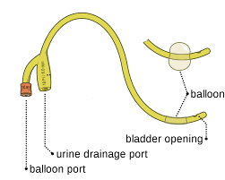
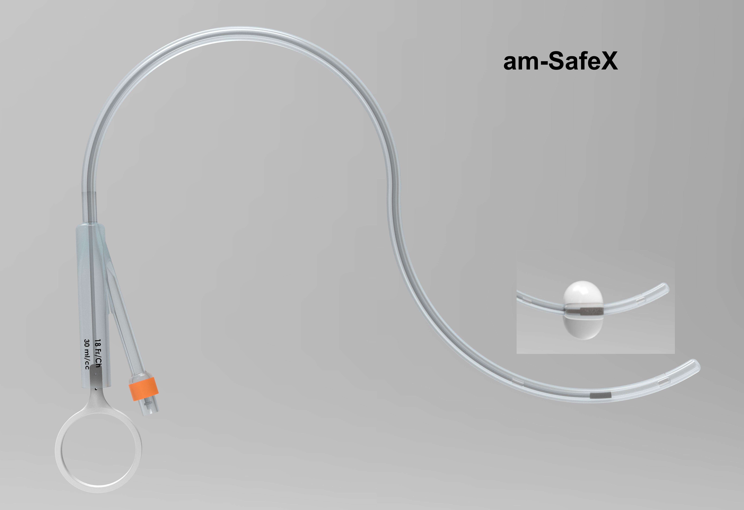
amSafeX® — Urethra-Safe Indwelling Catheter
CDSCO APPROVED — INDIA
SOLD IN INDIAN MARKET
INDIA PATENT 587173 GRANTED
US PATENT FILED
Required in every surgery to drain the bladder while the patient is immobile —
and for anyone living with urinary dysfunction
Patented obturator — pulling ring opens drainage only after placement is verified
Published evidence — 0/125 injuries (Elsevier, open access)
In market today — CDSCO licence; selling in India
Drop-in replacement — same insertion technique — no retraining
100% QC — 260±20 g pull-force tested on every unit
VS
Standard Foley
no way to confirm balloon is in bladder — 6.7–13.4 injuries / 1,000
amSafeX®
obturator blocks Eye 1 until balloon verified — 0 injuries in 125 patients
Latex & 100% silicone variants, 2-way / 3-way, all French sizes

Slide 4
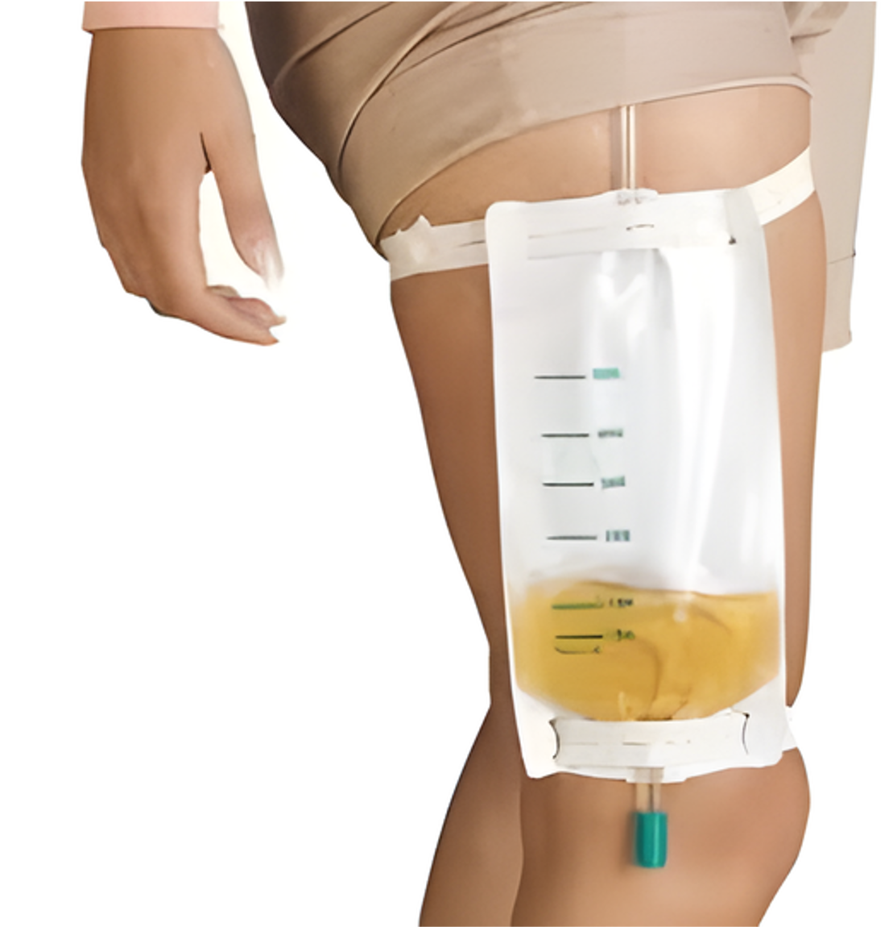
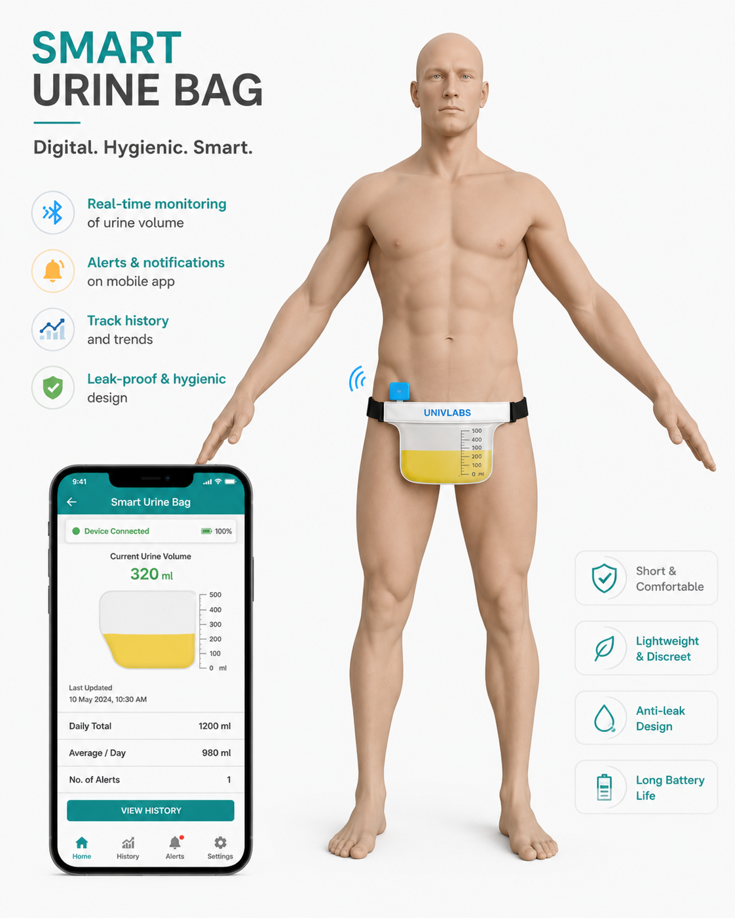
amSmart UroWear® — Smart Wearable Urine Bag
US PATENT 12,419,777 B2 GRANTED
INDIA PATENT 535002 GRANTED
APP-CONNECTED SaaS
Required in every surgery to drain the bladder while the patient is immobile —
and for anyone living with urinary dysfunction
Dignity by design — wearable, invisible under clothing
Connected variant — MEMS flow sensor + BLE + mobile app
SaaS model — bag FREE; USD 1,000/patient-yr
Recurring revenue — subscriptions compound with installed base
Standard variant — sells without the app too
VS
Conventional urine bag
strapped to leg or hung on bed — visible, undignified, unmonitored
amSmart UroWear®
discreet under clothing — app shows volume, flow & alerts in real time

Slide 5
One Patient, Two Interconnected Products
Every indwelling catheter patient needs a urine collection bag.
amSafeX and amSmart serve the same patient, at the same time.
SAME PATIENT
catheterised patients drain into a bag 24/7
amSafeX® catheter — the safe entry point
amSmart® bag — the recurring companion
Cross-sell built in — every amSafeX sale creates an amSmart customer — one sales call, two revenue lines, higher lifetime value per patient
Bundled offering — hospitals buy a safety system (catheter + monitored drainage), not two commodities

Slide 6






LEADERSHIP TEAM · ENGINEERS & CLINICIANS
200+ years combined expertise — deep operators, world-class clinicians, global advisors
AM
SA
Sunil Kumar Singh
Prof. Dr. Anil Mandhani
Sara Al hassnaoui
Founder & CEO
Co-Founder & CTO, Urology
Marketing
B.Tech Electronics · 20+ yrs · ex-Stryker, ZF
MBBS, MS, MCh · 30+ yrs · Chairman Urology, Fortis
Executive Business Administration
M2-Healthcare Business
RS
AJ
Rupinder Singh
Ajit Manocha
Venkat Bhagavati
President, Sales
Mentor & Advisor
VP- Regulatory Affairs
Gold Medallist Biotech · 25+ yrs · BD
CEO/President SEMI Global · ex-CEO GlobalFoundries
MS- Bioengineering
~127 professionals · R&D in Gurugram, Bengaluru & Lille (France) · ISO 13485 manufacturing
UnivLabs · Series A
14

Slide 7
Market: USD 6 B, Led by Incumbents With Old Designs
$2.16 B
$6.08 B
$1.4 B+
global Foley catheter market (2025), CAGR 5.3–7.2%
all urinary catheters → $8.2 B by 2031
urine collection devices; smart niche ~18% CAGR
Teleflex (TFX)
$1.99 B revenue; urology ~$1.4 B
Rüsch Foley, UroLift — global #2
Coloplast (COLO-B)
~$4.2 B; Continence Care #1, +7%
SpeediCath — premium benchmark
BD / Bard (BDX)
UCC ~$341 M/qtr, +11.6%
Bardex, PureWick — global #1 Foley
Well Lead (300642)
$215 M TTM
China's largest latex Foley manufacturer
Romsons (India)
~$120 M est.
India volume leader — price floor
All incumbents sell the unchanged 1937 Foley design.
None offers a urethra-safe obturator catheter or an app-connected wearable urine bag.

Slide 8
The Ask for Contract Manufacturing : USD 5 Million @20%
USD 2.7 Million
Working Capital
USD 1.9 Million
India Marketing & Sales
USD 1.4 Million
US and EU Regulatory Approval
Get catheter contract Manufactured for Sales
Asset-light scale-up — production under contract manufacturing — CDSCO licence already secured
Hospital & ICU salesforce — urology departments, corporate hospital chains, government tenders
amSmart pilots — subscription rollout with early-adopter hospitals and home-care providers
Clinical evaluation — multi-centre studies in the US and Europe building on the published Indian evidence
FDA 510(k) filing — amSafeX predicate pathway; De Novo assessment for amSmart Connected
CE MDR filing — Notified Body submission with clinical evaluation report
Capital-efficient: revenue in India today funds operations while FDA/CE unlock the USD 6 B global market.

Slide 9
After FDA & CE: Three Paths to Scale
With US & EU approvals secured, UnivLabs will evaluate the value-maximising route to global manufacturing and sales:
1. Build
2. Buy In
3. License
Own Factory
Acquire a Stake
Global Royalty Model
Set up dedicated manufacturing — the 90-acre, 1 M units/day plant blueprint (DPR ready: USD 309 M, Y5 revenue USD 438 M)
Take equity in the upcoming large-scale catheter factory — capacity without full capex, faster time-to-volume
License amSafeX & amSmart to global players (Teleflex/Coloplast/BD class) for manufacturing and sales under royalty
Optionality is the strategy:
regulatory approvals + granted patents + India traction make every path viable — investors participate in whichever maximises returns.

Slide 10
Model 1 - UD 5.5 Million : Contract Manufacturing & Product Sales
REVENUE (units × ASP × utilisation × working days)
USD Million | Year 1 | Year 2 | Year 3 | Year 4 | Year 5
amSafeX Latex | 2.1 | 3.1 | 5.2 | 8.3 | 12.5
amSafeX Silicone | 3.2 | 4.9 | 8.1 | 13.0 | 19.4
amSmart Standard | 0.0 | 3.5 | 14.0 | 24.5 | 31.5
amSmart SaaS | 0.0 | 3.9 | 15.6 | 27.3 | 35.1
ICU Variant | 0.0 | 0.0 | 0.0 | 0.0 | 0.0
Export/Tender | 0.0 | 0.0 | 0.0 | 0.0 | 0.0
TOTAL REVENUE | 5.3 | 15.4 | 42.9 | 73.1 | 98.5
P&L (asset-light)
USD Million | Year 1 | Year 2 | Year 3 | Year 4 | Year 5
Revenue | 5.3 | 15.4 | 42.9 | 73.1 | 98.5
Contract manufacturing cost (CMO) | (2.7) | (7.4) | (18.0) | (28.5) | (36.4)
Gross Profit | 2.7 | 8.0 | 24.9 | 44.6 | 62.1
R&D | (0.5) | (1.4) | (3.4) | (5.8) | (7.9)
Sales & Marketing | (1.9) | (4.0) | (9.4) | (14.6) | (17.7)
Admin & Overhead | (0.4) | (1.1) | (2.6) | (4.4) | (5.9)
EBITDA | (0.2) | 1.5 | 9.4 | 19.7 | 30.5
EBITDA margin | -3.0% | 10.0% | 22.0% | 27.0% | 31.0%
Depreciation (setup capex) | (3.0) | (3.0) | (3.0) | (3.0) | (3.0)
Interest | 0.0 | 0.0 | 0.0 | 0.0 | 0.0
PBT | (3.2) | (1.5) | 6.4 | 16.7 | 27.5
Tax | 0.0 | 0.0 | (1.6) | (4.2) | (6.9)
PAT — Net Profit | (3.2) | (1.5) | 4.8 | 12.5 | 20.7
PAT margin | -59.4% | -9.5% | 11.3% | 17.2% | 21.0%
No plant, PAT-positive from Year 3;

Slide 11
Model 2
Big Game : USD 50 Million - Build USD 300 Million Giga Factory — 5-Year P&L
 | Year 1: starts 24 months after investment
P&L Item (USD M) | Year 1 | Year 2 | Year 3 | Year 4 | Year 5
Revenue | 41.2 | 141.0 | 275.2 | 385.3 | 474.8
Raw Material & Direct Costs (year-wise RM%) | -16.5 | -50.7 | -90.8 | -119.4 | -142.4
Gross Profit | 24.7 | 90.2 | 184.4 | 265.9 | 332.4
Gross Margin % | 60% | 64% | 67% | 69% | 70%
Staff Costs | 13.9 | 17.7 | 21.4 | 24.0 | 25.2
Power & Utilities | 14.0 | 23.2 | 31.2 | 36.8 | 40.0
Sales & Marketing | 12.1 | 15.0 | 17.6 | 19.8 | 22.0
Admin & Overheads | 9.0 | 10.8 | 12.3 | 13.8 | 15.0
EBITDA | -24.3 | 23.6 | 101.9 | 171.5 | 230.1
EBITDA Margin % | -59% | 17% | 37% | 45% | 48%
Depreciation | 15.0 | 15.0 | 15.0 | 15.0 | 15.0
Interest & Finance Charges | 22.7 | 25.1 | 27.8 | 24.3 | 20.8
PBT (Profit Before Tax) | -62.0 | -16.5 | 59.1 | 132.2 | 194.3
Tax (25%) | 0.0 | 0.0 | 14.8 | 33.1 | 48.6
PAT — Net Profit After Tax | -62.0 | -16.5 | 44.3 | 99.2 | 145.7
PAT Margin % | -151% | -12% | 16% | 26% | 31%

Slide 12
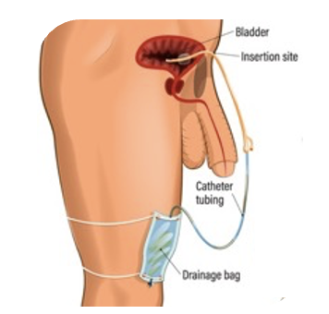
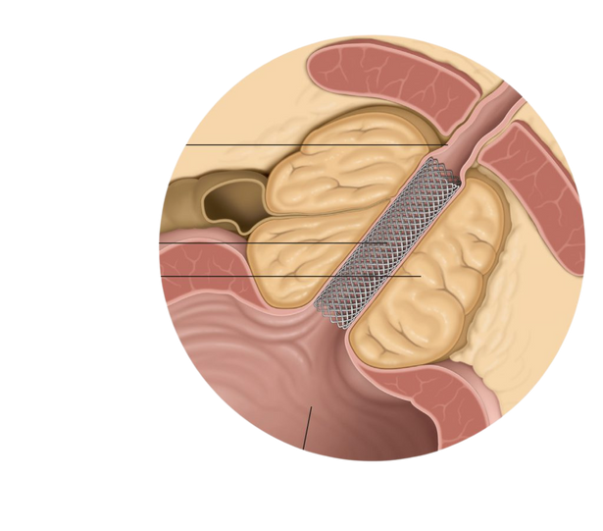
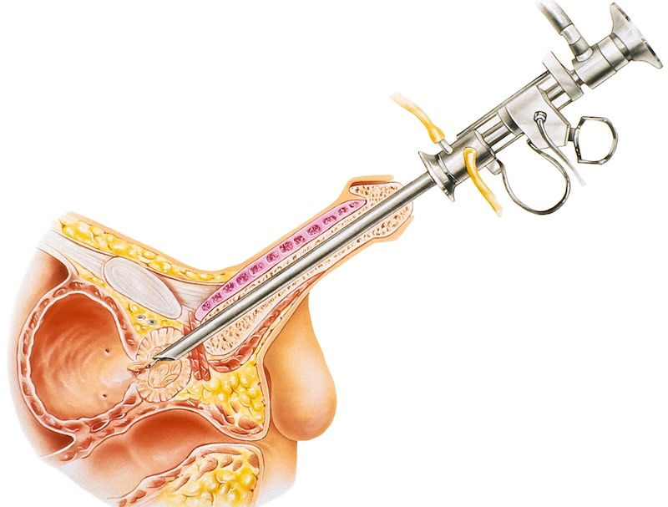
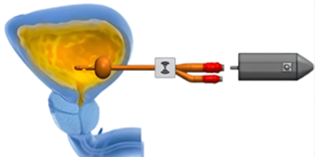
Pipeline: The Urology Category Platform
Beyond catheter + bag, two patent-pending products extend the same urology channel:
SupraSense™ — SupraPubic Catheter
Biodegradable Prostate Stent
VS
VS
Sensor-enabled suprapubic drainage for long-term care; bladder pressure monitoring; patent application under process
Scrapping vs Biodegradable Stenting: BPH relief without repeat procedures — stent degrades after therapy window; patent application under process
Each pipeline product sells to the same urologists, hospitals and distributors as amSafeX & amSmart.

Slide 13
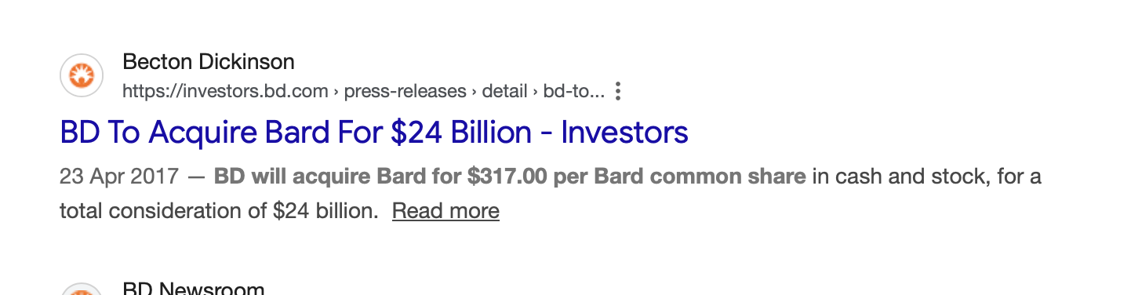
Annexure — Market Research & Sources (June 2026)
Global market size & growth
Price benchmarks (per unit, USD)
Foley / indwelling catheters
$2.16 B (2025)
CAGR 5.3–7.2%
Latex Foley 2/3-way
$0.40–3.00
India ₹85 MRP; US/EU $1.50–3.00
Urinary catheters — all types
$6.08 B → $8.2 B (2031)
CAGR 5.1%
100% silicone Foley
$4.00–16.00
India ₹400–700; US/EU $8–16
Foley share of urinary catheters
51.6%
largest segment
Wearable urine collection
$8.00–15.00
Coloplast / Hollister systems
Urine drainage / collection devices
~$1.4 B
~5.5% CAGR
Remote monitoring (SaaS comp.)
$50–100 /mo
supports $1,000/patient-yr
Smart urine monitoring (emerging)
~$0.3 B
~18% CAGR
WHO / LMIC tenders
$0.30–0.60
UNICEF supply catalogue
Competitor financials (latest reported)
Teleflex $1.99 B (urology ~$1.4 B) | Coloplast ~$4.2 B (Continence #1, +7%) | BD/Bard UCC ~$341 M/qtr (+11.6%)
Well Lead $215 M TTM (China #1 latex Foley) | Romsons ~$120 M est. (India #1 disposables)
Sources:
mordorintelligence.com/industry-reports/urinary-catheter-market | cognitivemarketresearch.com/foley-catheters-market-report | grandviewresearch.com
sec.gov/Archives — Teleflex FY2025 ARS & BD FY2025 8-K | coloplast.com/investors (AR 2024/25) | pitchbook.com (Well Lead 300642.SZ)
healthklin.com / romsons.in — India retail prices | unicef.org/supply — tender catalogue | Full annexure: AmSafeX_amSmart_DPR.docx, Annexure A

