Slide 1
Make Your Hospital
Urethra Injury Free
amSafeX — The Future of Safer Catheterization

Slide 2
AMSAFEX · THE PROBLEM
PATIENT SAFETY
A
INR 50 /USD 0.5
product
causing a lifelong hospital-acquired injury
in 13 out of 1,000 patients
Foley catheter
90+ years
6.7–13.4 /1000
The culprit device
Unchanged design
Iatrogenic Urethral UI
References
1. Loveday et al. epic3: evidence-based guidelines for preventing HAI. J Hosp Infect 2014;86 Suppl 1:S1-70
2. Bhatt N, et al. Prospective audit on urethral catheterization injuries. Can Urol Assoc J 2017;11(7):E302-6
The current foley catheter design has remained unchanged for over 90 years — Gomida amSafeX eliminates the root cause of iatrogenic urethral injury

Slide 3

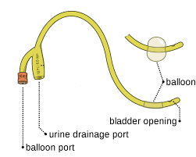
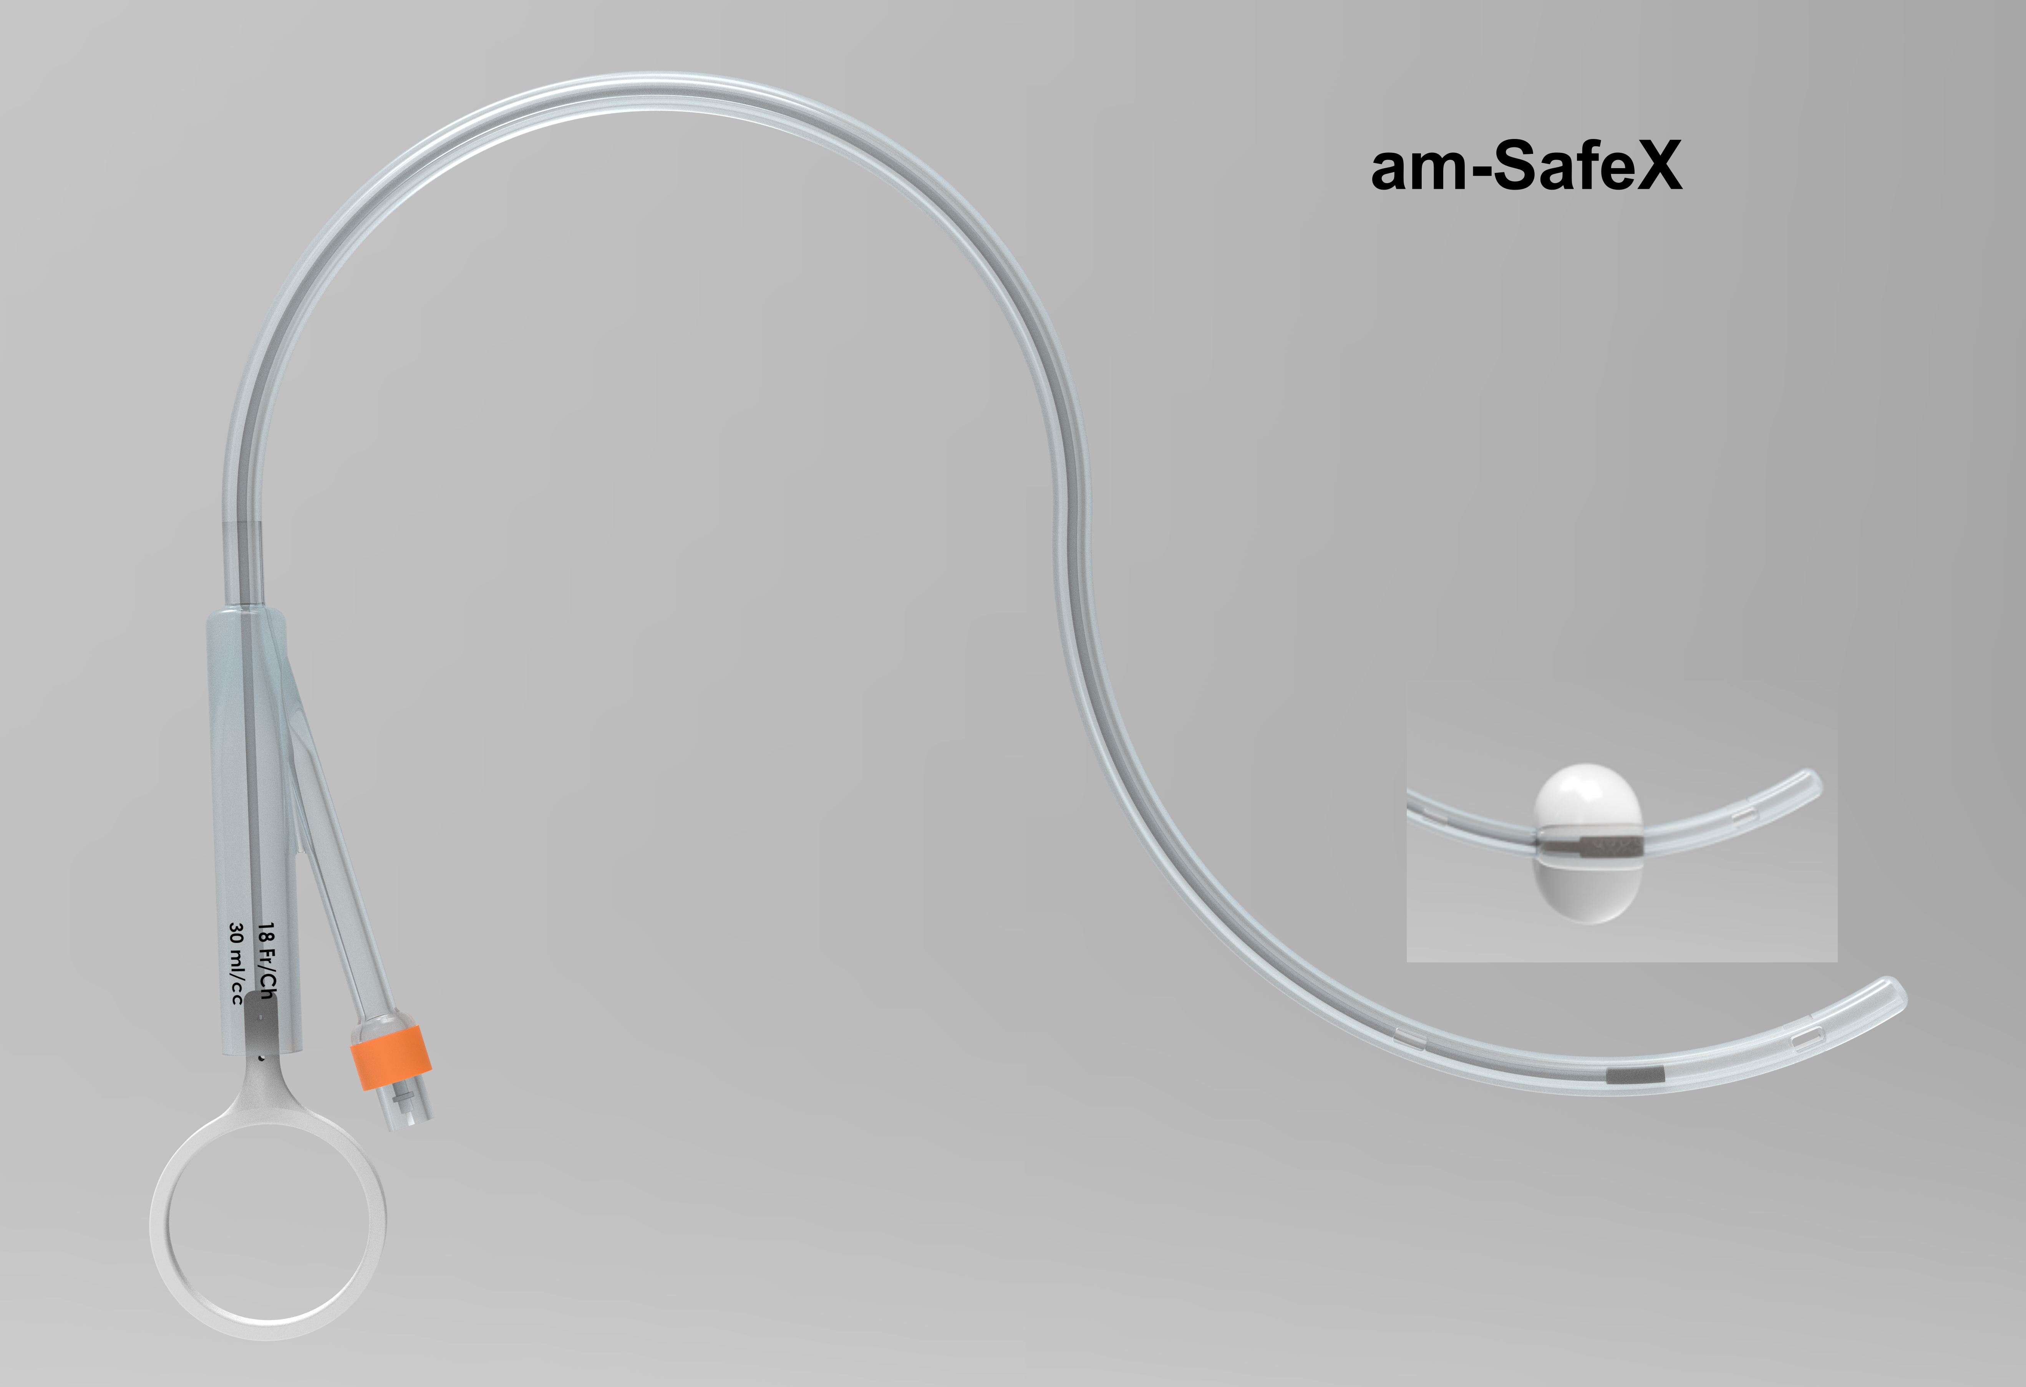
Regular Foley Catheter
amSafeX
THE FUTURE OF SAFER CATHETERIZATION
amSafeX Mechanism Diagram
Let's discover an innovation that puts patient safety
and clinical efficiency at the forefront.
Zero
INR 72
13:1000
urethral injuries
Cost
preventable events
Simple Change –
obturator & thread
STRICTLY CONFIDENTIAL | 22 May 2026

Slide 4
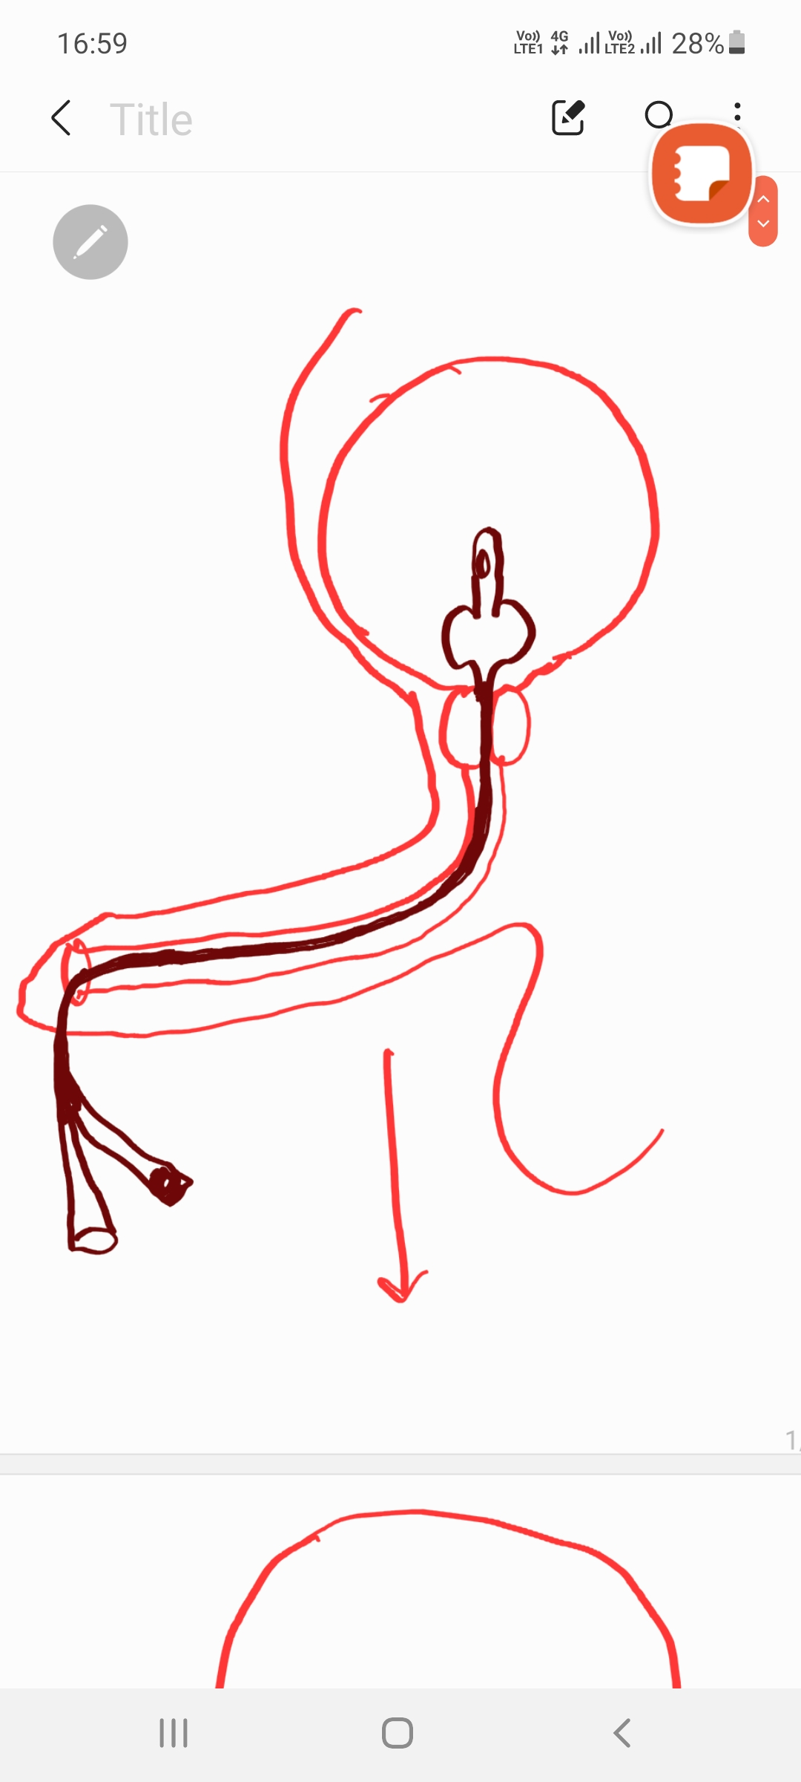
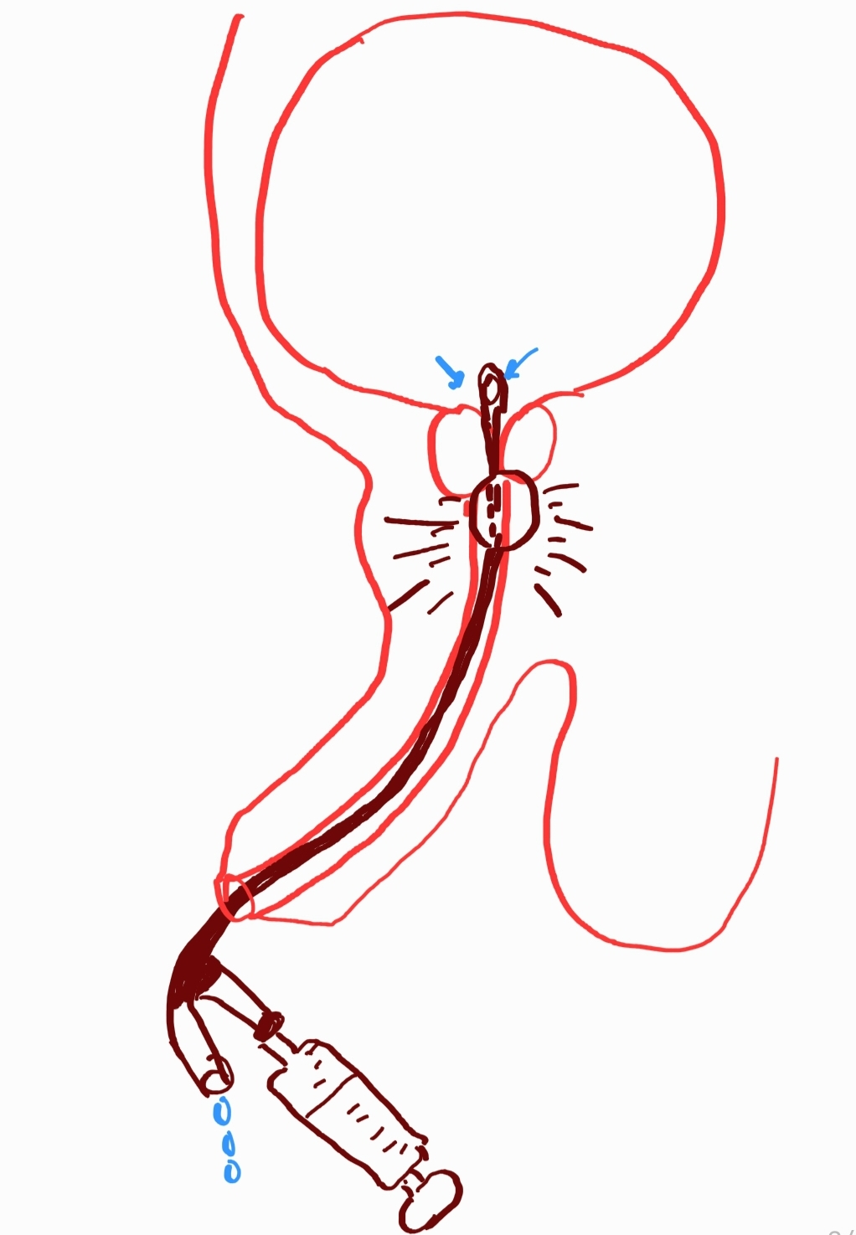
AMSAFEX · INJURY DUE TO DESIGN FLAW
PROBLEM: The balloon catheter's 90-year-old design is the problem.
CURRENT BALLOON CATHETER
THE DANGER
Urine Drainage Before Proper Placement
The catheter starts draining before the clinician confirms the balloon is inside the bladder — there is no feedback mechanism.
Balloon Inflation in the Urethra
OK
Not OK
FLAW: Urine drainage begins irrespective of balloon position
If the balloon is inflated while still in the urethra, it causes acute urethral rupture — a painful, immediately recognisable emergency.
03
If balloon is still in the urethra when inflated — rupture occurs
Lifelong Complications
04
Urethral rupture leads to stricture, recurrent infections, chronic pain, and often requires surgical reconstruction.
amSafeX eliminates this failure mode by engineering a confirmation mechanism before balloon inflation is possible

